Slide 1
CIS 678 Final Project: Genetic Algorithms
Matthew Lueder

Slide 2
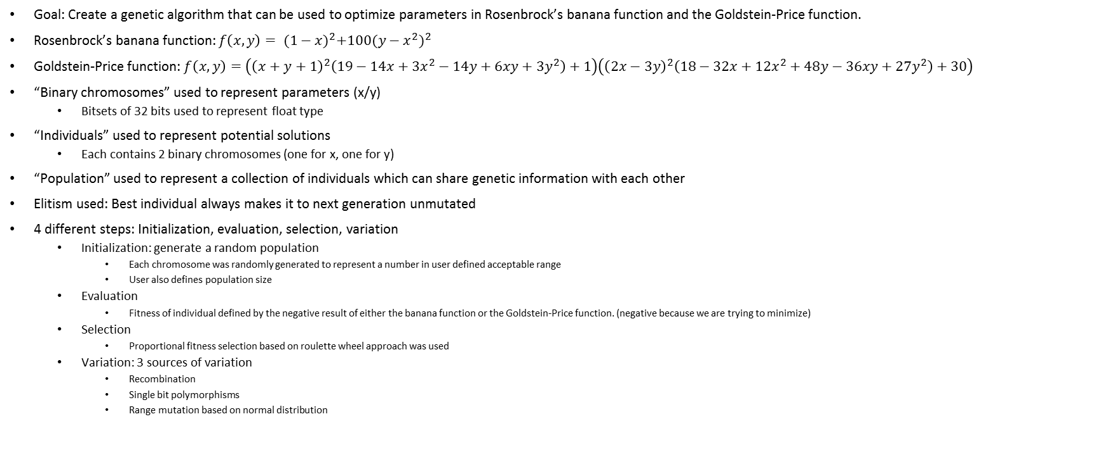
Overview
Goal: Create a genetic algorithm that can be used to optimize parameters in Rosenbrock’s banana function and the Goldstein-Price function.
Rosenbrock’s banana function: $f\left(x,y\right)= {(1−x)}^{2}+100{(y−x^{2})}^{2}$
Goldstein-Price function: $f\left(x,y\right)=\left({\left(x+y+1\right)}^{2}\left(19−14x+{3x}^{2}−14y+6xy+3y^{2}\right)+1\right)\left({\left(2x−3y\right)}^{2}\left(18−32x+12x^{2}+48y−36xy+27y^{2}\right)+30\right)$
“Binary chromosomes” used to represent parameters (x/y)
Bitsets of 32 bits used to represent float type
“Individuals” used to represent potential solutions
Each contains 2 binary chromosomes (one for x, one for y)
“Population” used to represent a collection of individuals which can share genetic information with each other
Elitism used: Best individual always makes it to next generation unmutated
4 different steps: Initialization, evaluation, selection, variation
Initialization: generate a random population
Each chromosome was randomly generated to represent a number in user defined acceptable range
User also defines population size
Evaluation
Fitness of individual defined by the negative result of either the banana function or the Goldstein-Price function. (negative because we are trying to minimize)
Selection
Proportional fitness selection based on roulette wheel approach was used
Variation: 3 sources of variation
Recombination
Single bit polymorphisms
Range mutation based on normal distribution

Slide 3
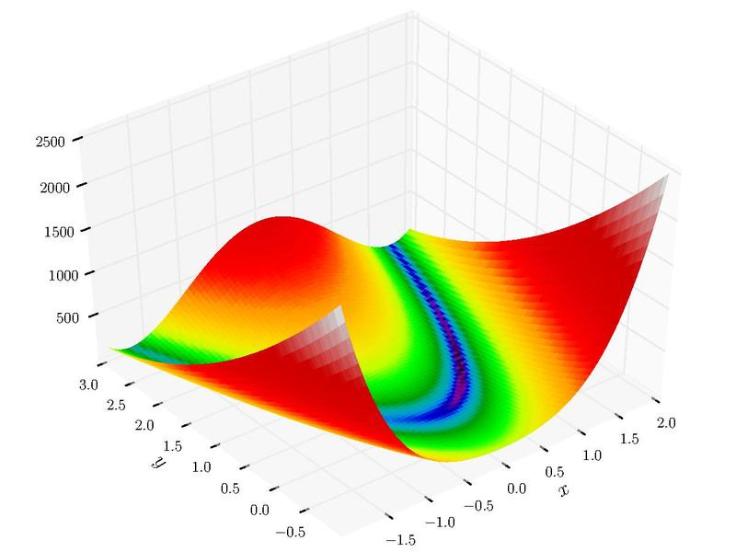
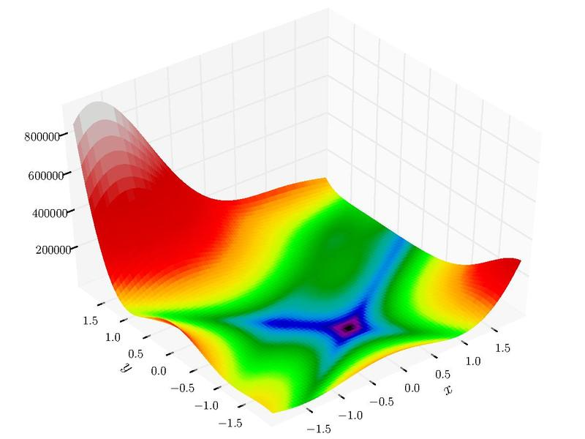
Test Functions Visualized
Rosenbrock’s Banana Function
Goldstein-Price Function

Slide 4
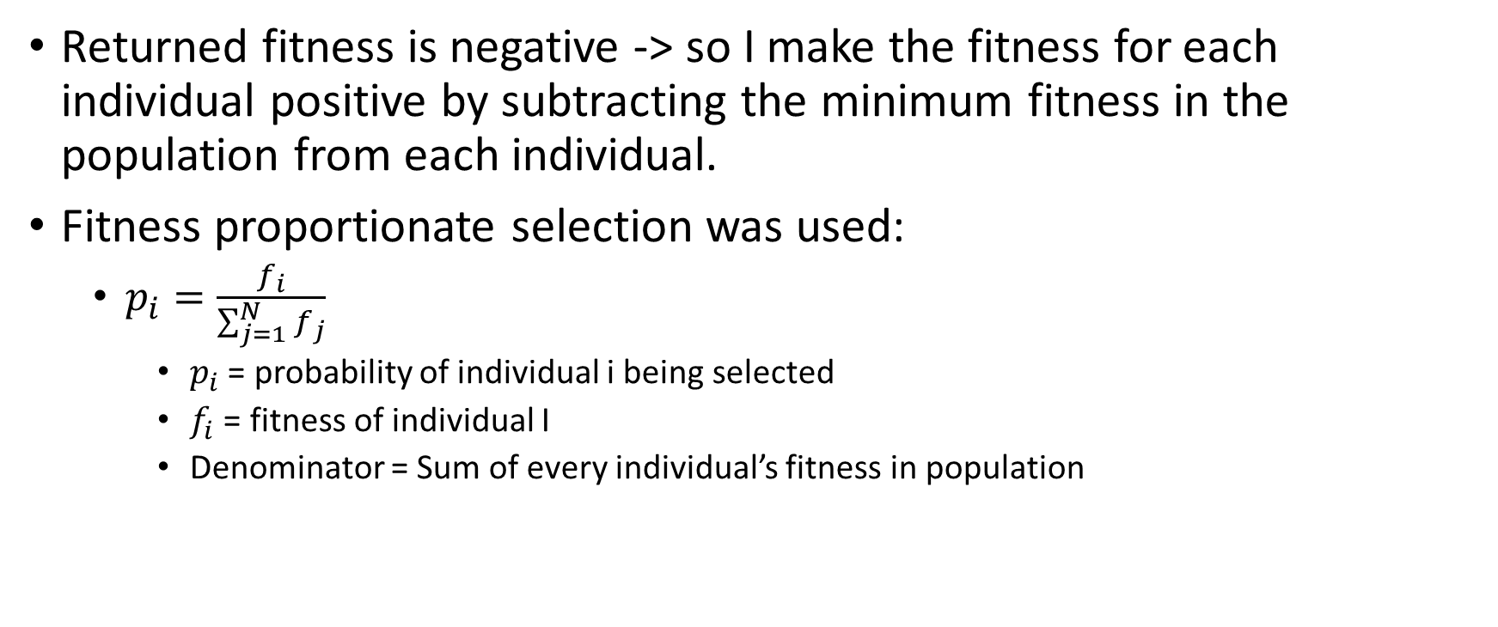
Selection
Returned fitness is negative -> so I make the fitness for each individual positive by subtracting the minimum fitness in the population from each individual.
Fitness proportionate selection was used:
$p_{i}=\frac{f_{i}}{\sum_{j=1}^{N}{f_{j}}}$
$p_{i}$ = probability of individual i being selected
$f_{i}$ = fitness of individual I
Denominator = Sum of every individual’s fitness in population

Slide 5
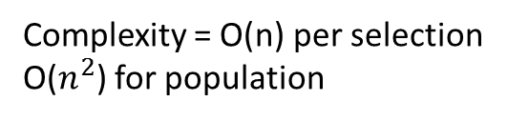
Selection Algorithm – Wikipedia’s suggestion
// Returns the selected index based on the weights(probabilities) int rouletteSelect(double[] weight) { // calculate the total weight double weight_sum = 0;
for(int i=0; i<weight.length; i++) { weight_sum += weight[i];
}
// get a random value double value = randUniformPositive() * weight_sum;
// locate the random value based on the weights for(int i=0; i<weight.length; i++) { value -= weight[i]; if(value <= 0) return i; }
// when rounding errors occur, we return the last item's index return weight.length - 1; }
Complexity = O(n) per selection
O($n^{2}$) for population

Slide 6
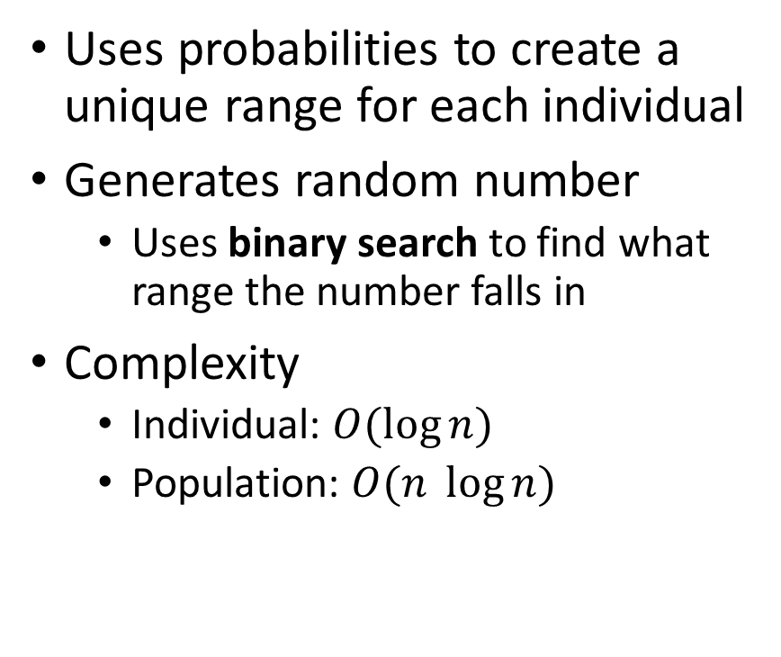
My Selection Algorithm
struct Range
{
Range(float start, float end) : start(start), end(end)
{}
friend bool operator< (const Range &r1, const Range &r2)
{
return r1.start < r2.start && r1.end < r2.end;
}
float start;
float end;
};
// Build weight vector
std::vector<Range> weights;
weights.reserve(m_size);
float last = 0;
// Get probabilities using proportional fitness selection and create a range
for (auto iter = scaledFitness.rbegin(); iter != scaledFitness.rend(); ++iter)
{
float next = last + (*iter / totalFitness);
weights.push_back(Range(last, next));
last = next;
}
std::vector<Individual> selected;
selected.reserve(m_size);
std::uniform_real_distribution<float> uRealDist(0.3, weights.back().end);
// locate the random values based on the weights
for (int j = 0; j < m_size; ++j)
{
float value = uRealDist(m_gen);
auto found = std::lower_bound(weights.begin(), weights.end(), Range(value, value));
int index = found - weights.begin();
selected.push_back(m_individuals[index]);
}
Uses probabilities to create a unique range for each individual
Generates random number
Uses binary search to find what range the number falls in
Complexity
Individual: $O(\log{n})$
Population: $O(n \log{n})$

Slide 7
Variation
Recombination
1111111111 1111110000
0000000000 0000001111
Rate defined in global parameter
Single bit polymorphism
1111111111 11111011111
Rate defined in global parameter
Mutate based on normal distribution
0x41c40000 = 24.5 24.802 = 0x41c66a7f
Mean of distribution to randomly sample from = the value of the chromosome
Rate and standard deviation defined by global parameters

Slide 8
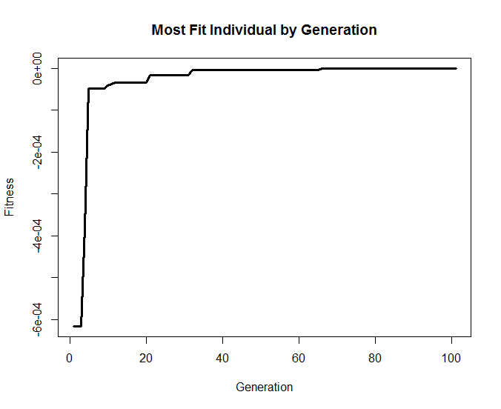
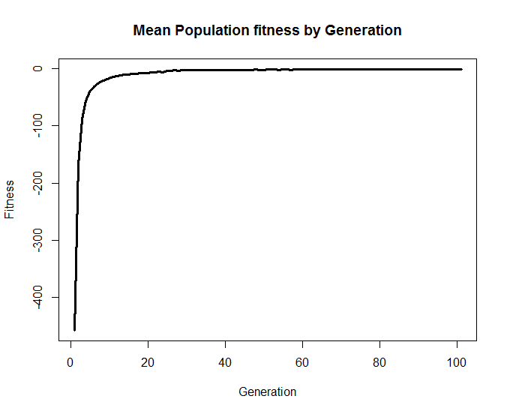
Results – Banana Function RECOMBINATION_RATE = 0.60, SNP_RATE 0.05, NORMAL_MUT_RATE = 0.4, NORMAL_MUT_SD = 0.01, POP_SIZE = 50,000
Best individual = (0.999446, 0.998888)

Slide 9
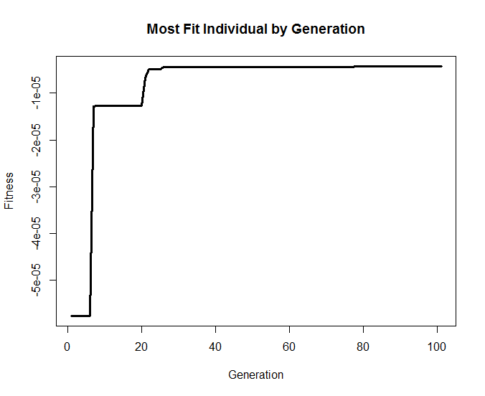

Results – Banana Function RECOMBINATION_RATE = 0.60, SNP_RATE 0.05, NORMAL_MUT_RATE = 0, POP_SIZE = 50,000
Best individual = (1.00207, 1.00412)

Slide 10
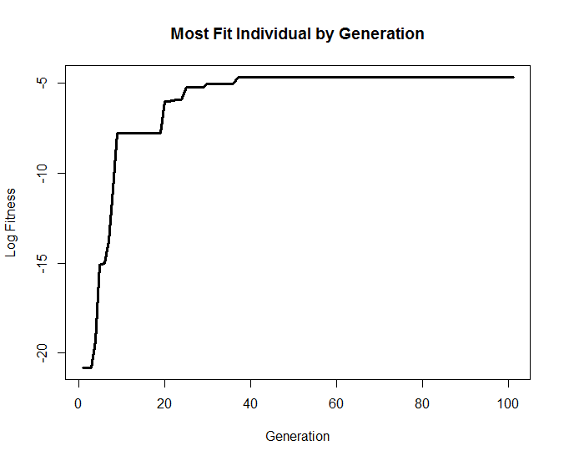
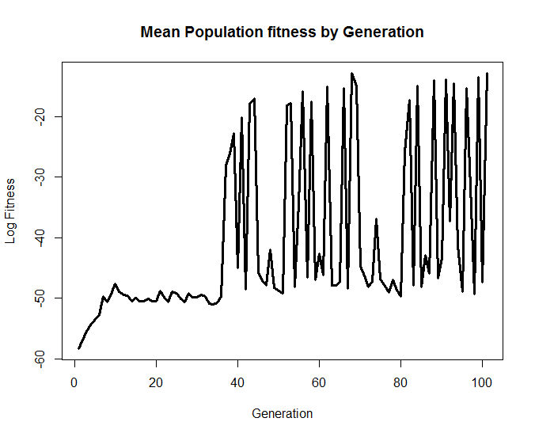
Results – Banana Function – Wide Range (-1,000,000 – 1,000,000) RECOMBINATION_RATE = 0.60, SNP_RATE 0.05, NORMAL_MUT_RATE = 0.4, NORMAL_MUT_SD = 0.01, POP_SIZE = 50,000
Best individual = (11.3713, 129.313)

Slide 11
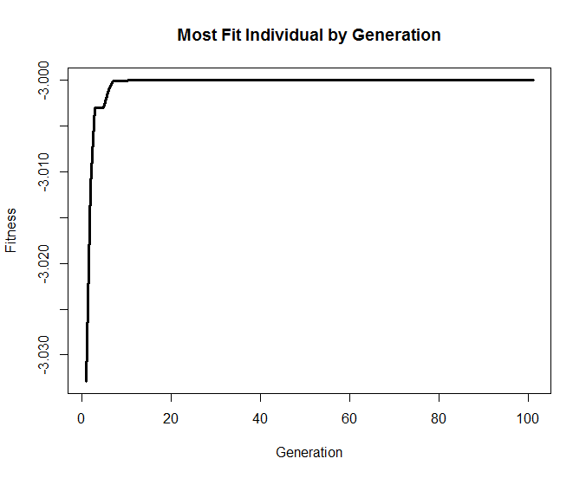
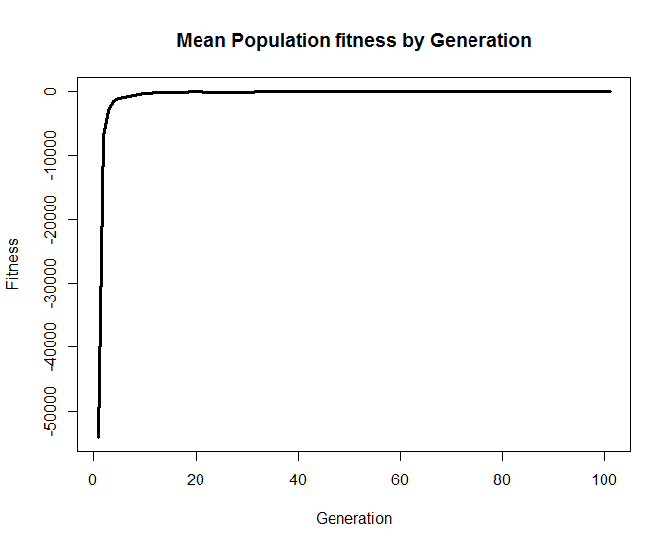
Results – Goldstein-Price Function RECOMBINATION_RATE = 0.60, SNP_RATE 0.05, NORMAL_MUT_RATE = 0.4, NORMAL_MUT_SD = 0.01, POP_SIZE = 50,000
Best individual = (0.000122698, 0.999802)

Slide 12
Discussion
Delicate: Changing parameters could easily make results much less accurate
Best individual fitness and mean population fitness plateaued after a number of generations
Need to look into this more
Possibly because selection is weighted based on fitness
Needs to be big differences in fitness to result in big differences in selection probability
When population closes in on correct answer, fitness differences are smaller
Mean fitness unstable after removing strict constraints on X and Y
These constraints also constrain possible mutations
Maybe caused by recombination and SNPs

